Slide 1
Slide 2-1

Slide 2
Slide 2-2

Slide 3
Slide 2-3

Slide 4
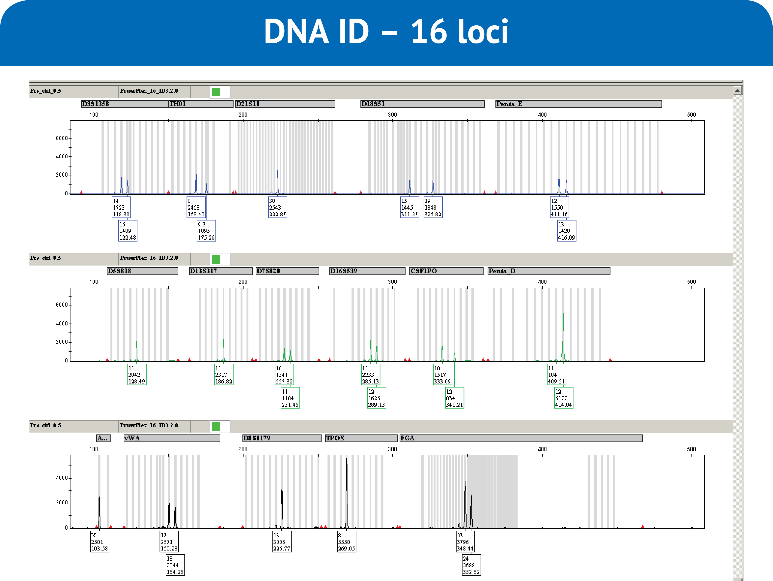
A
B
C
Slide 2-4

Slide 5
Slide 2-5

Slide 6
Slide 2-6

Slide 7
Slide 2-7

Slide 8
Slide 2-8

Slide 9
Slide 2-9

Slide 10
Slide 2-10

